Slide 1
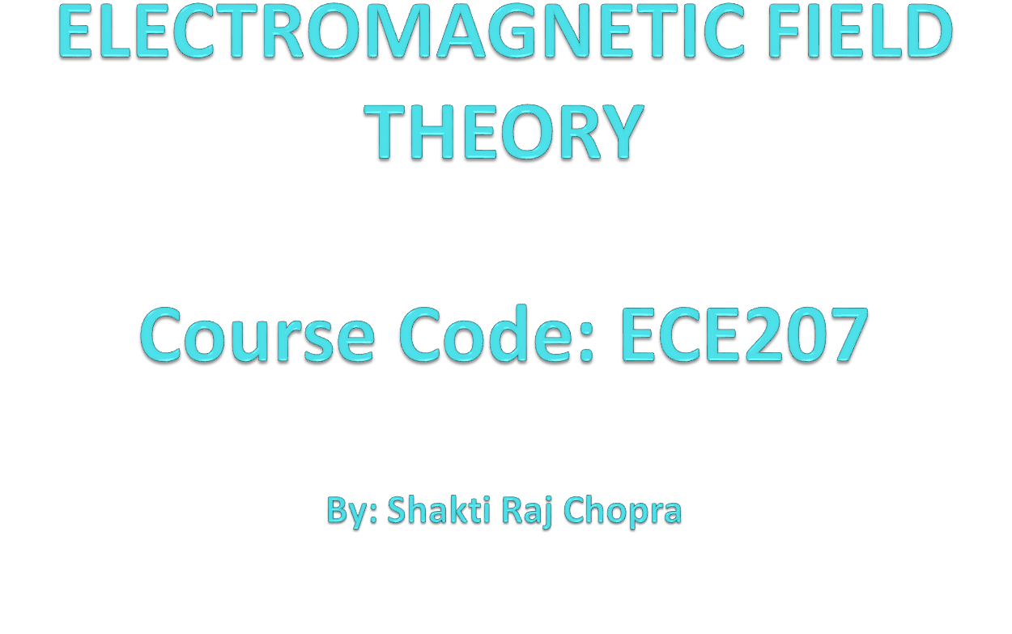

Slide 2
Books
Text Book:
1. PRINCIPLES OF ELECTROMAGNETICS
By - MATTHEW N.O. SADIKU, 4th 2009 OXFORD UNIVERSITY
PRESS, INDIA
Reference Book:
1. ELECTROMAGNETIC WAVES AND RADIATING SYSTEMS
By - EDWARD C. JORDAN 5th PRENTICE HALL

Slide 3
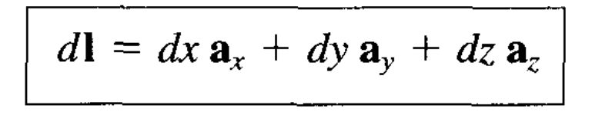
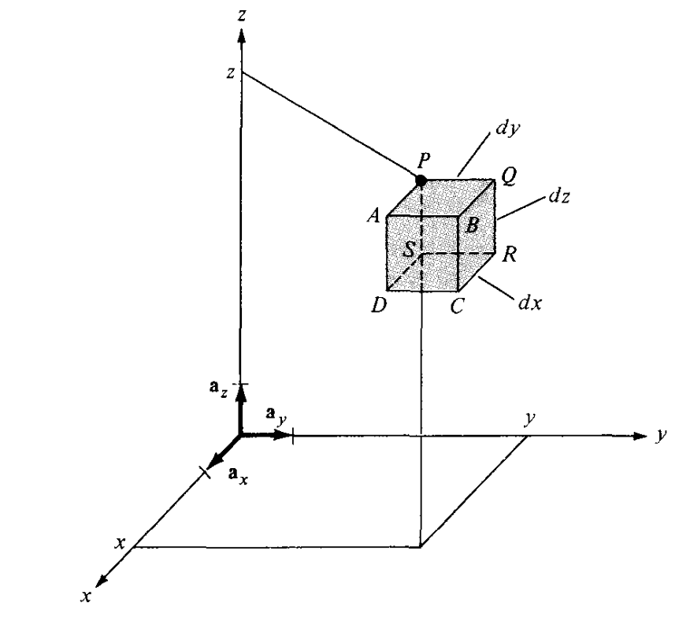
DIFFERENTIAL LENGTH, AREA, AND VOLUME
  Cartesian Coordinates,
  Differential displacement is given by:

Slide 4
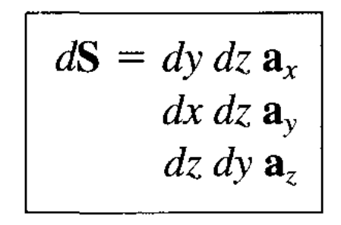
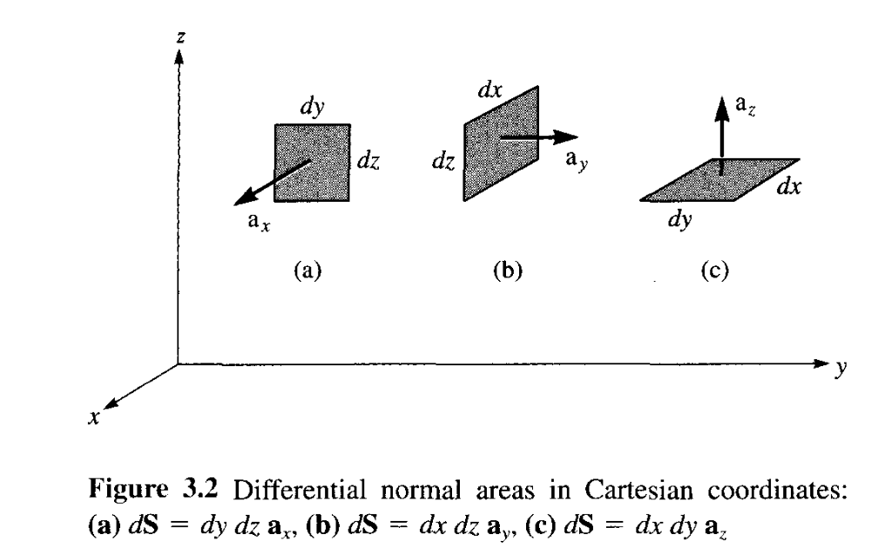
  Differential normal area is given by,

Slide 5
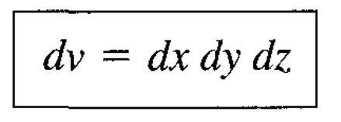
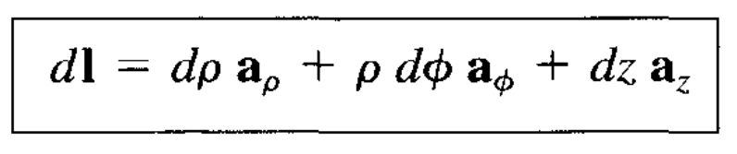
Differential volume is given by:
Cylindrical Coordinates
Differential displacement is given by:

Slide 6
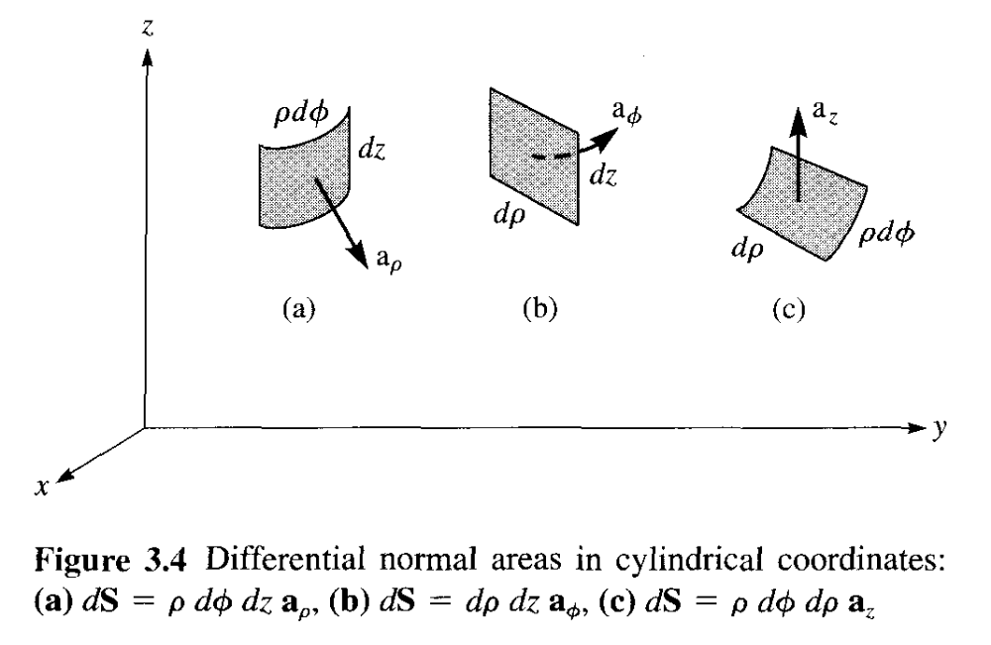


Slide 7
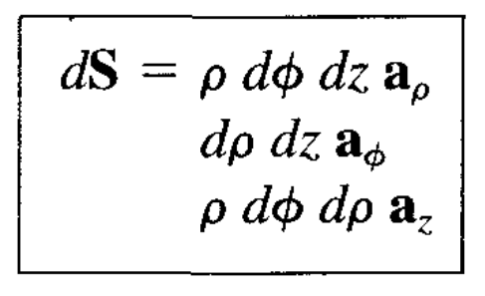
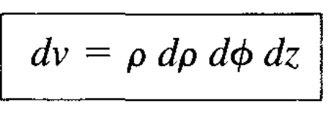
Differential normal area is given by:
Differential volume is given by:

Slide 8
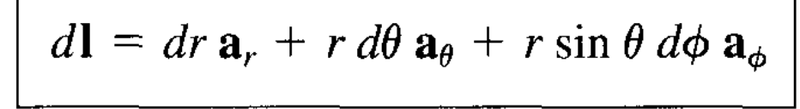
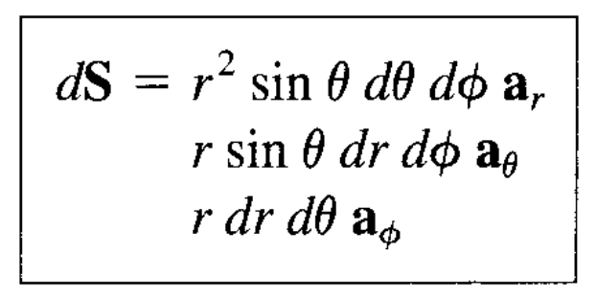
Spherical Coordinates
The differential displacement is
The differential normal area is

Slide 9
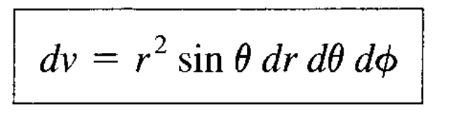
The differential volume is

Slide 10
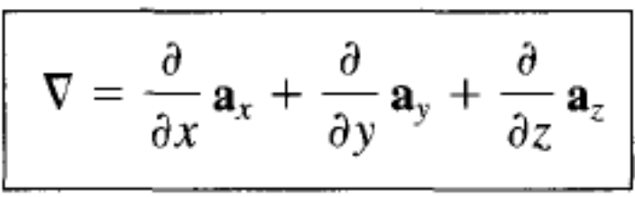
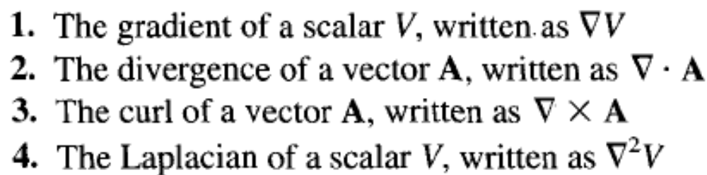
Del Operator
  The del operator is the vector differential operator. In Cartesian coordinates,
This vector differential operator, otherwise known as the gradient operator, is not a vector in itself, but when it operates on a scalar function, for example, a vector ensues. The operator is useful in defining

Slide 11
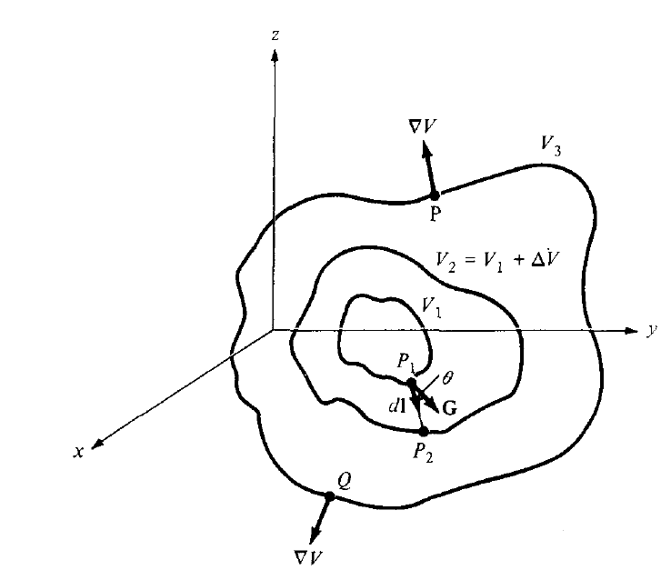
GRADIENT OF A SCALAR
The gradient of a scalar field V is a vector that represents both the magnitude and the direction of the maximum space rale of increase of V.

Slide 12
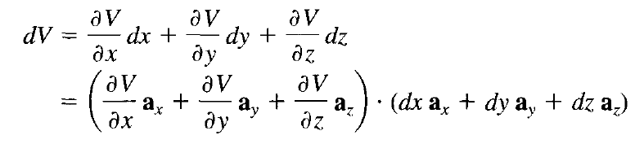
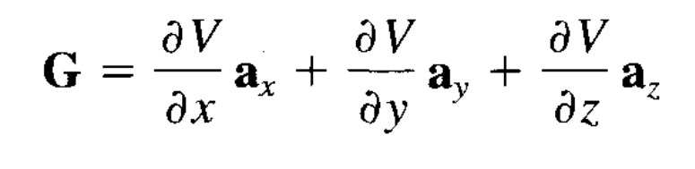
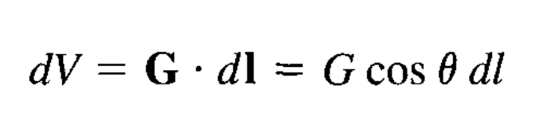
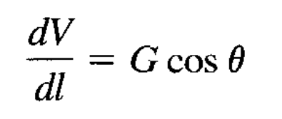
A mathematical expression for the gradient can be obtained by evaluating the difference in the field dV between points P1 and P2 of Figure where V,, V2, and V3 are contours o which V is constant. From calculus:
Let

Slide 13
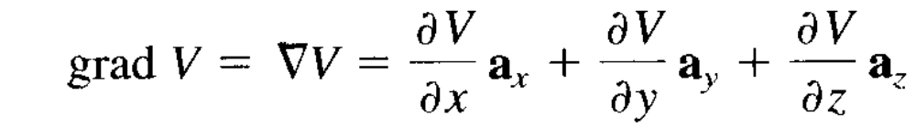
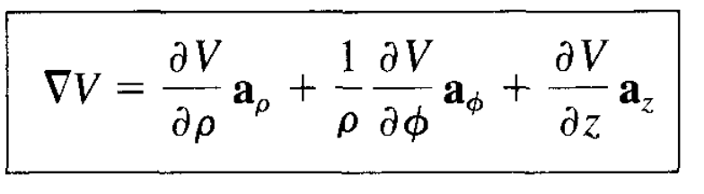
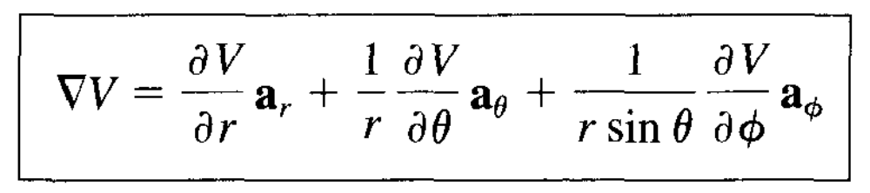
By definition, G is the gradient of V. Therefore
for cylindrical coordinates,
and for spherical coordinates,

Slide 14
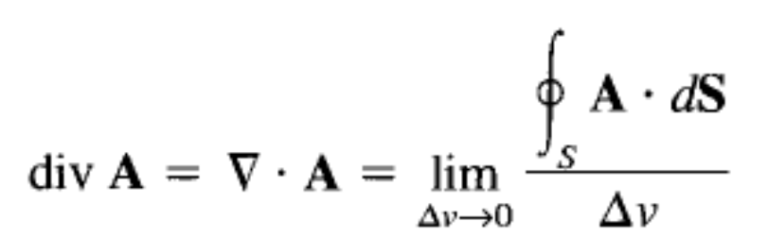
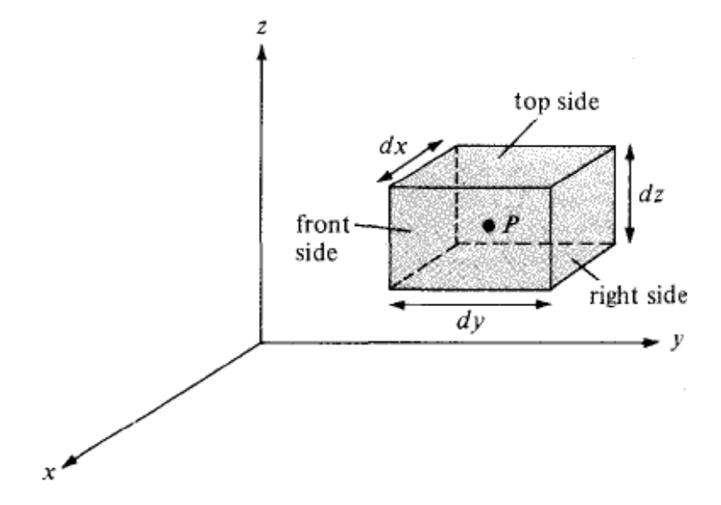
Divergence
The divergence of A at a given point P is total outward flux per unit volume as the volume shrinks about P.

Slide 15
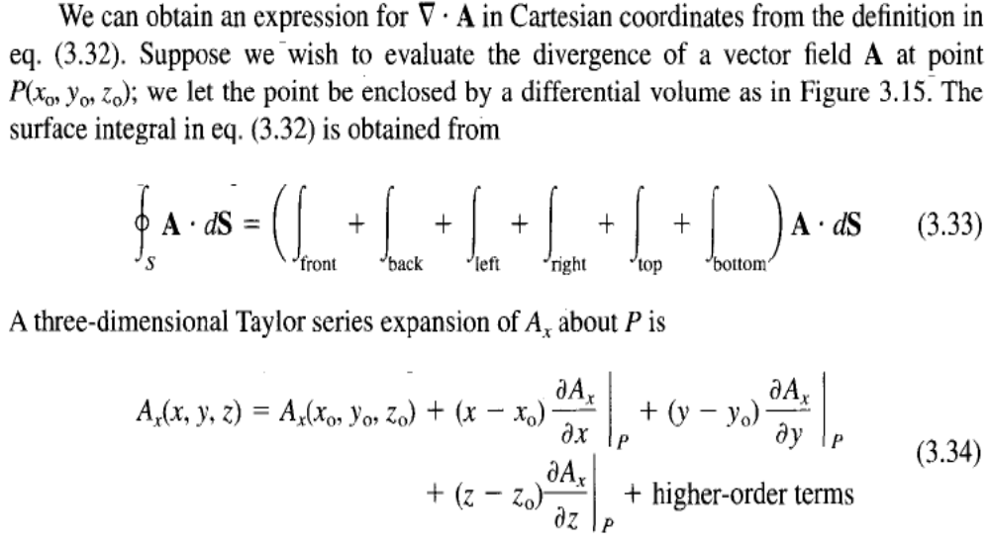
Divergence

Slide 16
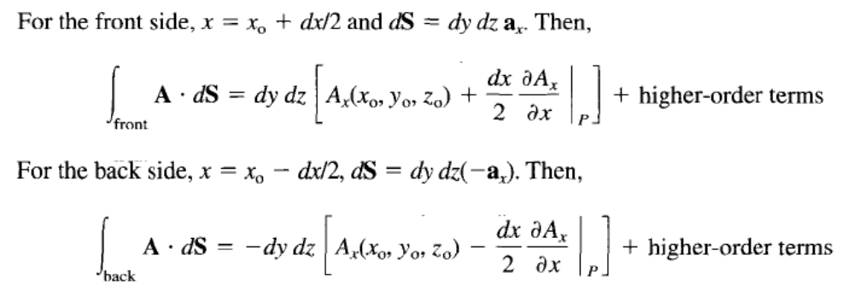
Divergence

Slide 17
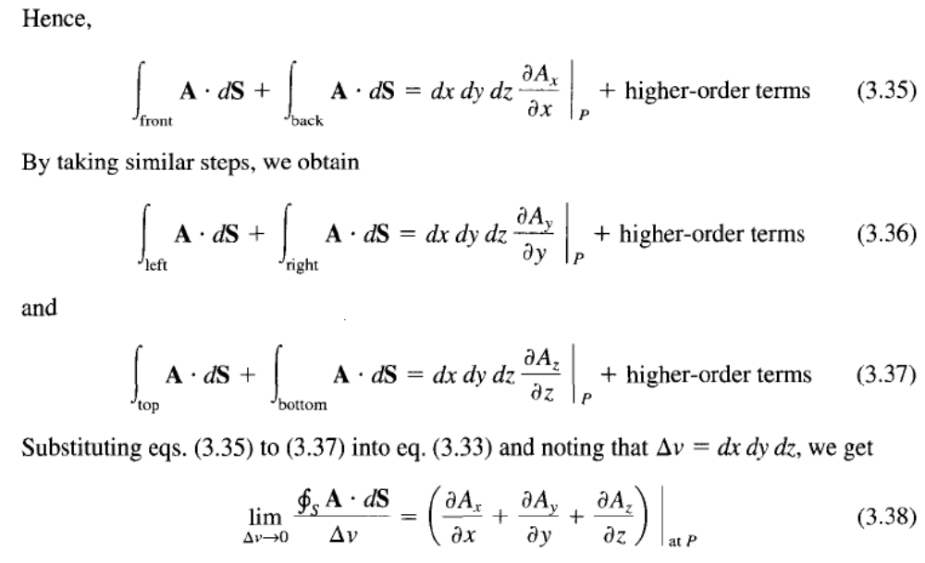
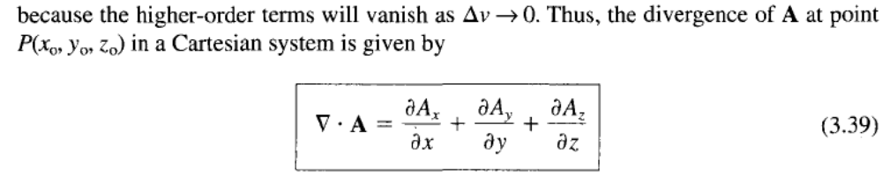

Slide 18
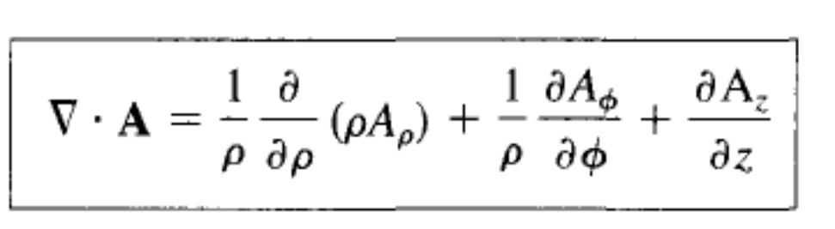
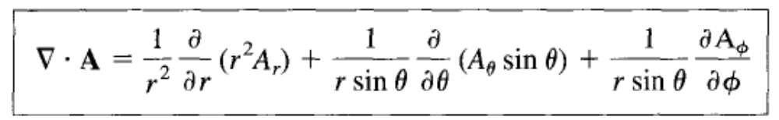
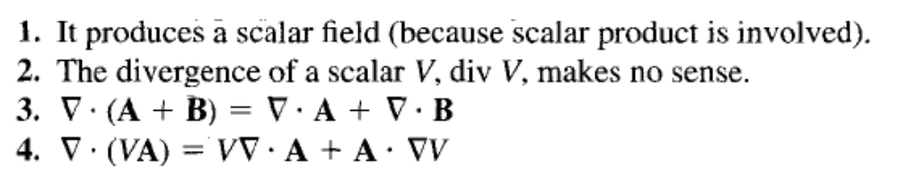
Divergence
In Circular Coordinate
In Spherical Coordinate

Slide 19
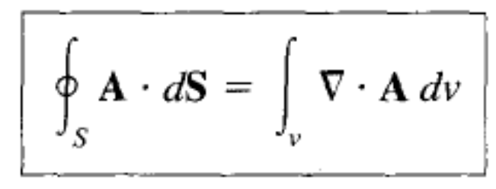
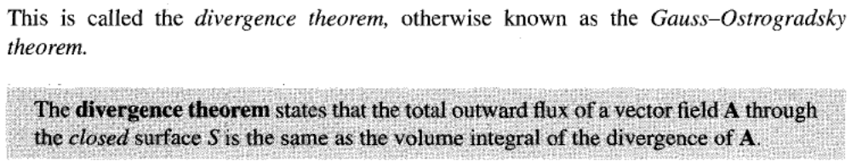
Divergence Theorem

Slide 20
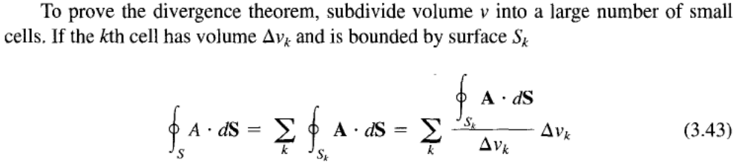
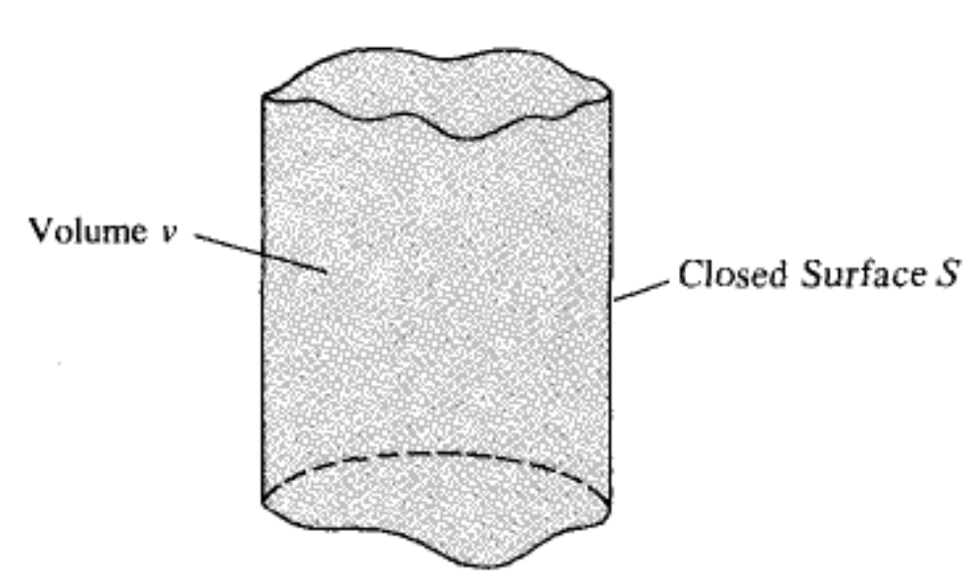
Divergence Theorem: Proof

Slide 21
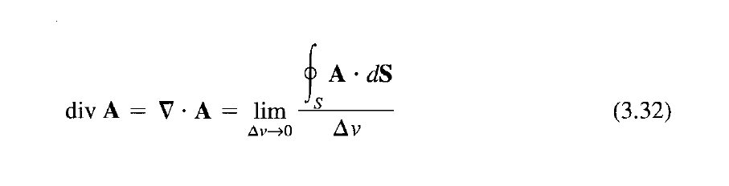
Since the outward flux to one cell is inward to some neighboring cells, there is cancellation on every interior surfaces
So the sum of the surface integrals over Sk's is the same as the surface integral over the surface 5. Taking the limit of the right-hand side of eq. (3.43) and incorporating eq. (3.32) gives ie Divergence

Slide 22
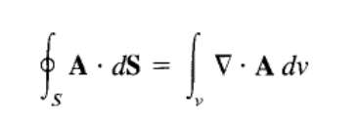
Divergence Theorem
That is Divergence Theorem.
Using the Divergence Theorem, we can convert the surface integral to volume integral using Divergence.

Slide 23
Have a look at following URL
  http://llovesumi.tripod.com/menu.htm

Slide 24
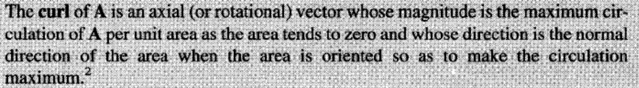
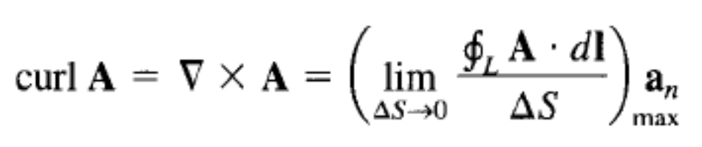
Curl of a Vector Field

Slide 25
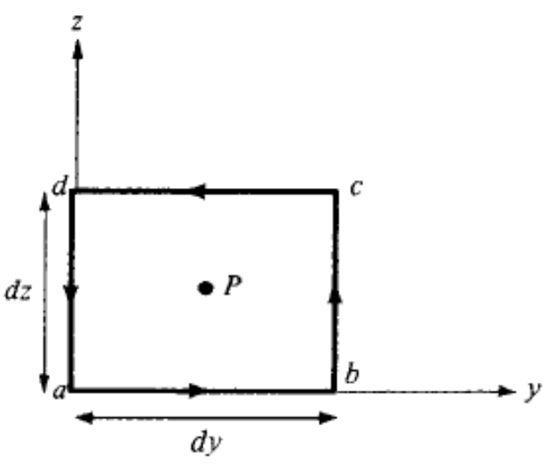
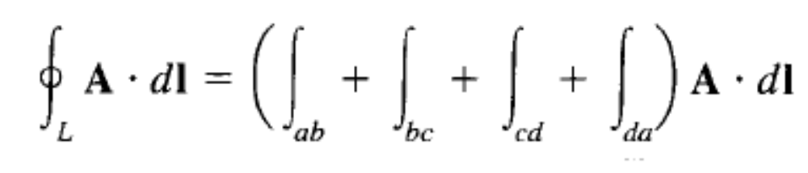
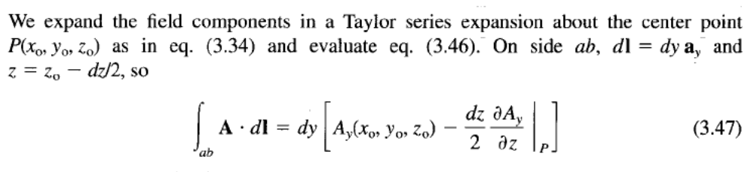
Curl: Derivation

Slide 26
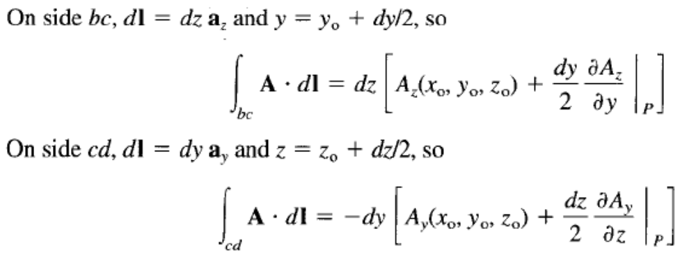
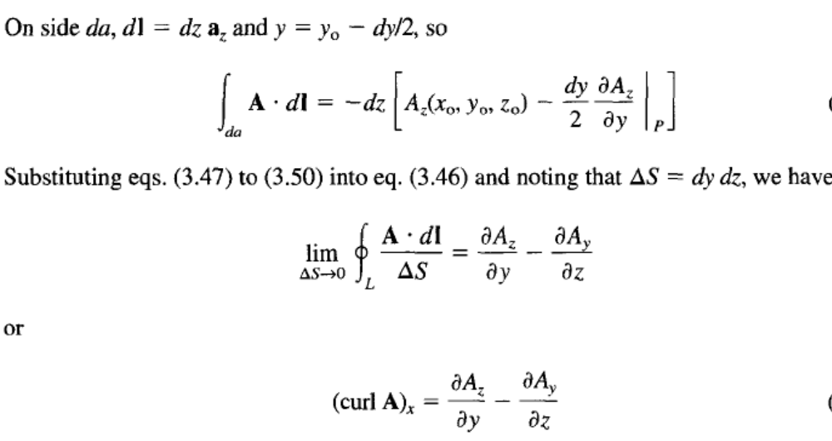

Slide 27
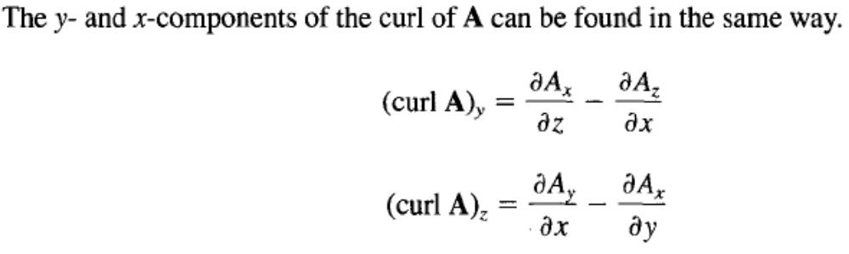
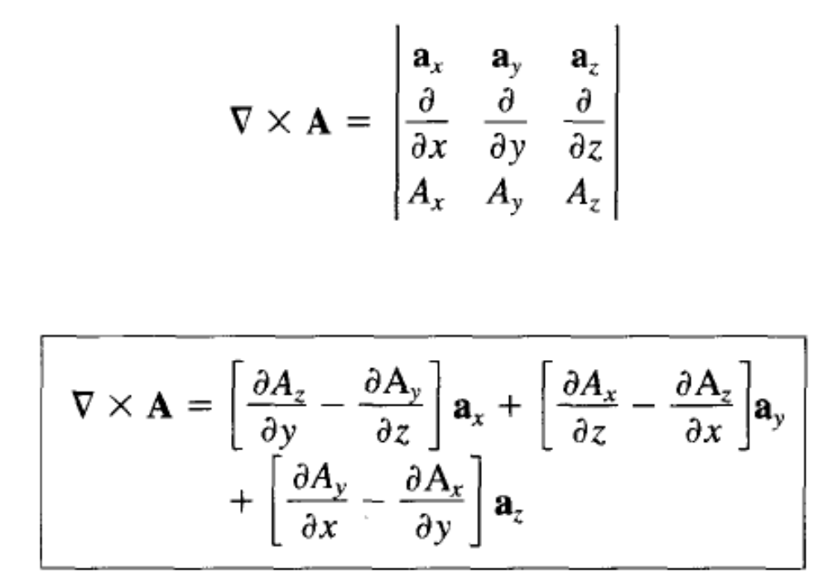

Slide 28
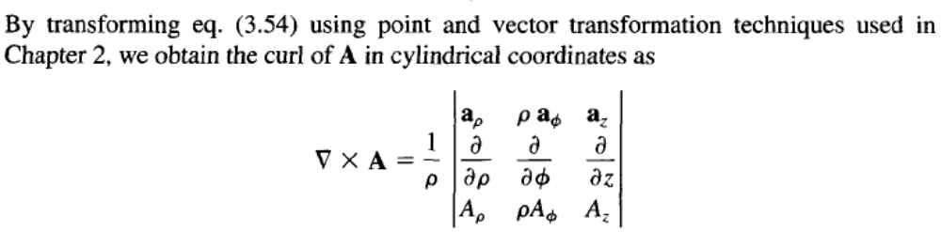
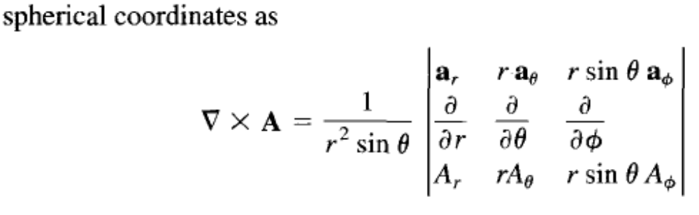

Slide 29
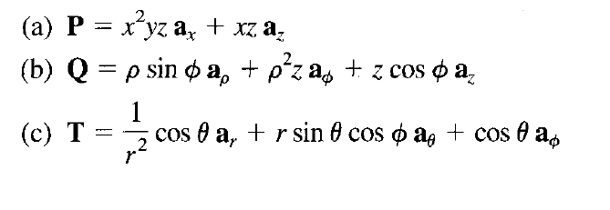
Determine the Curl

Slide 30

Solution

Slide 31


Slide 32

Determine the Curl

Slide 33

Ans

Slide 34

Stokes’ Theorem

Slide 35


Stokes’ theorem

Slide 36

Stokes’ theorem

Slide 37



LAPLACIAN OF A SCALAR
It is a single operator which is the composite of gradient and divergence operators. This operator is known as the Laplacian

Slide 38




Laplacian of a Scalar

Slide 39




Laplacian of Scalar Field
Poisson’s Equation

Slide 40




Laplacian of a Vector Field

Slide 41


